Slide 1
DHELKAYA HEALTH – INTERIM BRANDING
16 August 2022

Slide 2
WHAT’S IT ALL ABOUT?
Maldon Hospital integrated with Castlemaine Health in March 2022 to form Dhelkaya Health
Dhelkaya means ‘good/being healthy’ in the Dja Dja Wurrung language
The choice of an Indigenous name acknowledges the Dja Dja Wurrung’s traditional ownership of the lands on which we live and work and expresses our gratitude to the Dja Dja Wurrung for sharing them with us
Have you been wondering how to say ‘Dhelkaya’? Click on the sound button to find out…

Slide 3
SO WHAT’S A BRAND ANYWAy?
It’s a set of ideas in people’s minds shaped by a company, organisation or individual’s actions and recognised by a consistent visual and verbal style
It’s not a logo
A brand is what everyone reads, watches, imagines, suspects, projects, thinks, feels, sees, says, hears about an organisation, product or service

Slide 4
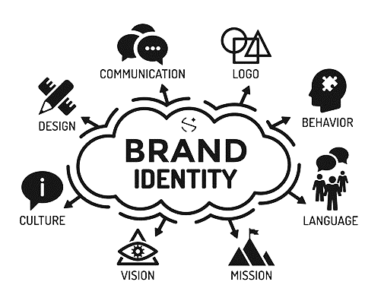
What’s a brand identity?
Brand identity can project four things: who you are; what you do; how you do it; where you want to go
It enables change to happen and emphasises that change has taken place
Brand identity is a design, marketing, communication & human resource tool; it influences every part of the organisation and every audience of the organisation; it’s an economical resource

Slide 5
WHY DO WE NEED IT?
To visually communicate our new identity to our staff, patients, residents and community
To communicate that our three organisations are now working together as one
To communicate that we are on a journey – this is an interim brand that will be in place for the next 12-18 months
And remember, we’re not ‘rebranding’ everything. Instead we’re applying the interim branding only in the most effective and cost effective ‘touchpoints’ eg. letterhead, websites, social media, brochures etc.

Slide 6
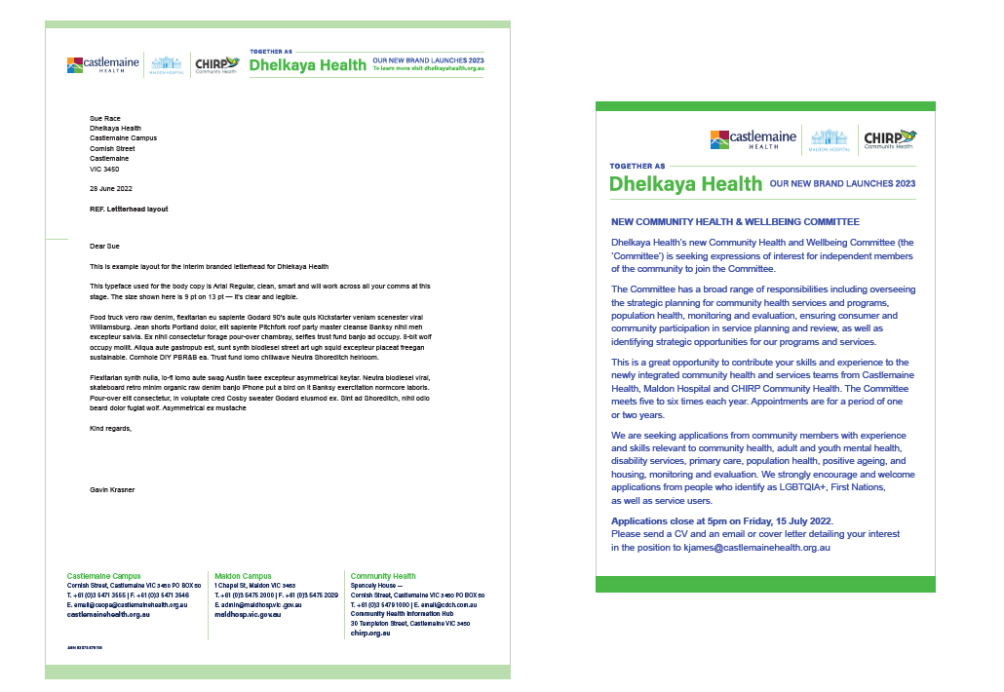
WHAT DOES IT LOOK LIKE?
PRINT & ADVERTISING

Slide 7
WHAT DOES IT LOOK LIKE?
PRESENTATIONS

Slide 8
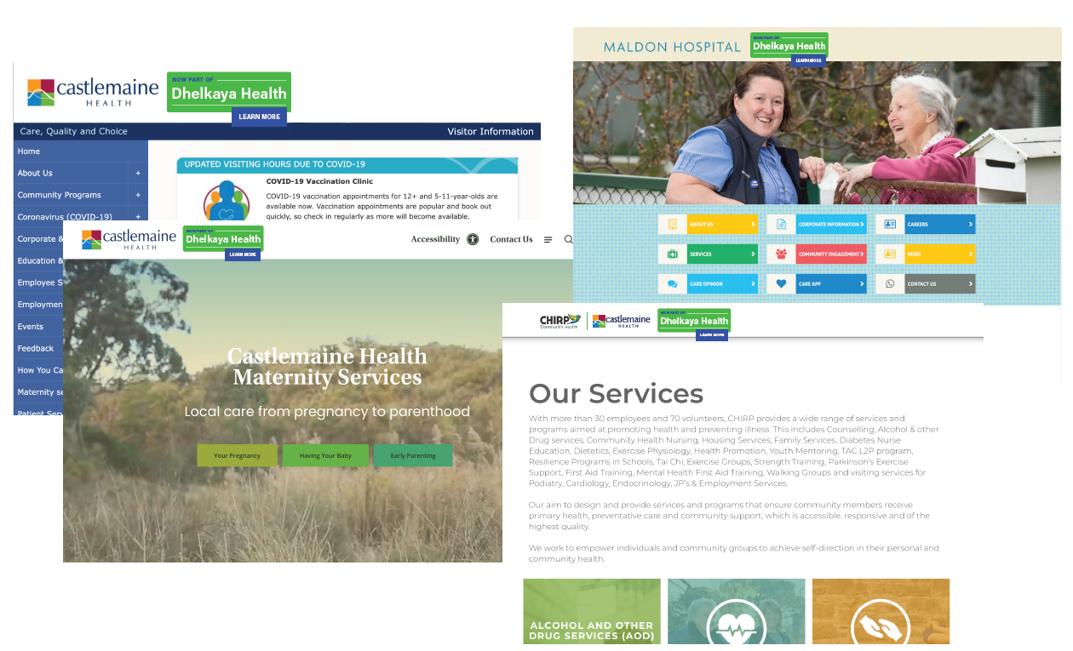
What does it look like?
DIGITAL

Slide 9
What does it look like?
BROCHURES

Slide 10
What does it look like?
EMAIL

Slide 11
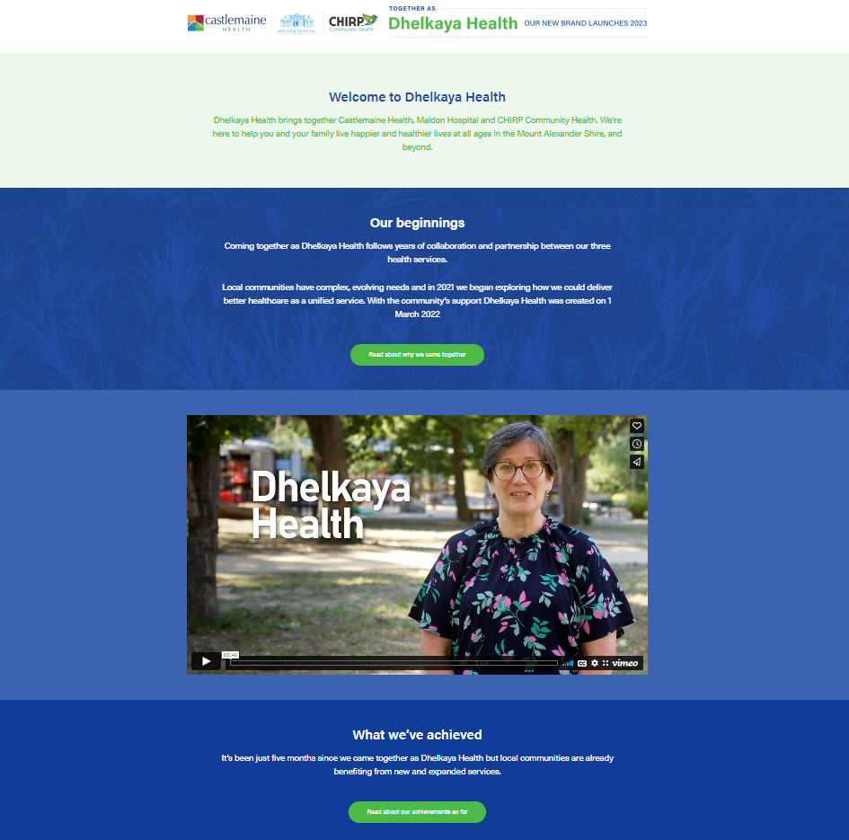
Where do I find them?
LETTERHEAD & POWERPOINT
on the intranet under ‘Communications’
BROCHURES
on the intranet under ‘Brochures/Leaflets’
DIGITAL
castlemainehealth.org.au
maldhosp.vic.gov.au
chirp.org.au
and now dhelkayahealth.org.au
EMAIL
set up guide will be available on the intranet under ‘Communications’ this week

Slide 12
Need more?
Thanks to Storyland for their advice and work on our interim branding.
For any questions about the interim branding, or requests for assistance with its application, contact Janine McCarthy on email jmccarthy@castlemainehealth.org.au or call 5471 3505

